Slide 1



Austen’s Untitled Platformer
An emulation of the smooth and rewarding controls of good 2D Platformers

Slide 2
What is this Project?
2D platforming game
Mario
Strong emphasis on movement

Slide 3
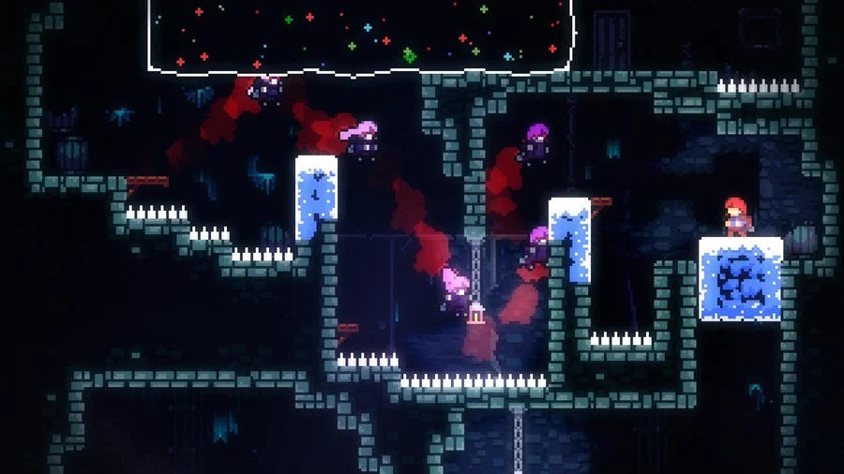
Why I went for this Project…
I personally really enjoy 2D platformers
Recently reached over 1000 played levels in Super Mario Maker 2
Grew up playing Flash and Plug-N-Play platformers
Run
Fireboy and Watergirl
Sonic the Hedgehog
Continue playing modern, more polished versions today
Super Mario Maker 2, Super Mario Brothers Deluxe
Celeste
Celeste Screenshots (trueachievements.com)

Slide 4
Why I went for this Project… Cont.
Most of these games shared at least one thing: Good and rewarding controls
Visuals that matched up with what the player is doing at that time
Sounds that reflect things happening and the environment around the player
Controls that have a good feel to them
Wanted to emulate the elements that make good platformer controls
Super Mario Maker Looks Nuts (kotaku.com.au)

Slide 5
Requirements

Slide 6
Minimum Viable Product, Must Haves
Strong, Polished Movement
Basic Animations that line up well with movement
Custom tilemap
1 or 2 levels showing off mechanics
Stationary obstacles

Slide 7
Version 1.0, Should Haves
Sound Effects
Royalty-Free Music
Varied movement mechanics(Ice, Wind etc.)
Moving obstacles
Enemies with basic movement

Slide 8
Version 2.0, Want to Haves
More Levels
Better, more complicated level design
More complicated enemy movement(Throwing/Shooting, Dashes)

Slide 9


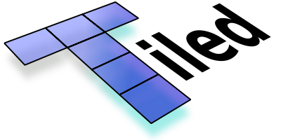



Tools Used

Slide 10
The Code

Slide 11
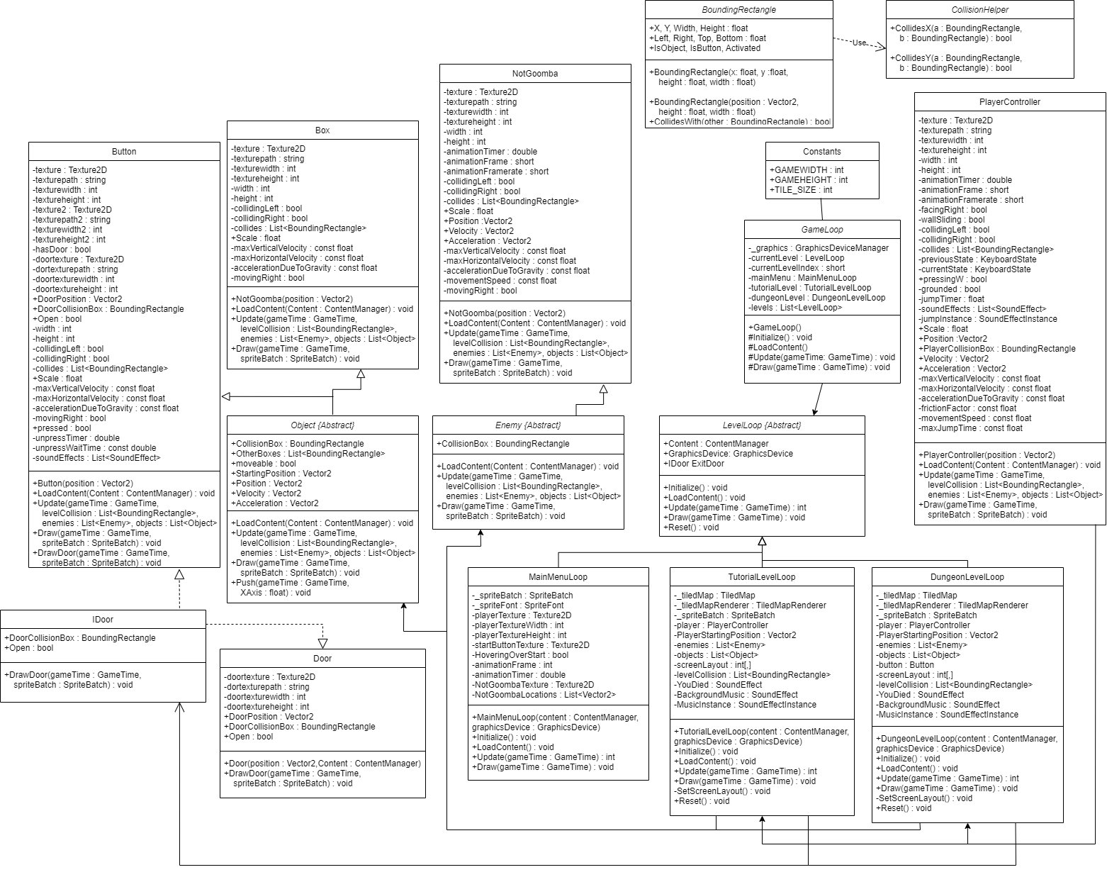

Slide 19


Slide 23


Slide 25
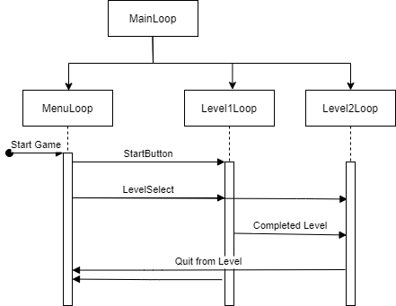

Slide 26
Player Controller
Basic Physics
Max velocity, acceleration due to gravity, friction with floor
Walking/Running
Different Acceleration if grounded vs not grounded
Animation speeds up as movement gets faster
Jumping
Base value
Extra height from horizontal velocity
Hold down jump for higher jump
Sound ends as jump ends
Wall-Jumping

Slide 27
Collision
Many things depend on collision with BoundingRectangles
Interacting with objects
Wall-sliding, wall-jumping, jumping
Death
Not falling into the floor
Needed to make a system I was happy with
Some cases are easy
Biggest problem is collision rectification

Slide 28
Collision Rectification
I tried a few ways to fix the collision
Monogame.Extended built-in collision system
Monogame.Extended nu-get package is out of date, so it didn’t work
Minimum Translation Vectors
Way too complicated
Settled on multi step system
Check for collisions with Enemies, Objects, or the Level Collision
Order list from closest to furthest
Check if the collision is still happening
Check which direction has the smallest overlap and move in the opposite of that direction

Slide 29
Testing

Slide 30
Testing
I personally tested every aspect of the game until it was at a point I was happy with
If it did not feel right it was fixed or overhauled
Gave to my friend Andrew to see how it felt
He broke it

Slide 31
Live Demo

Slide 32
Future Plans
Add more player control variance like ice, wind, or water
Add more enemies and objects with more complicated functions
Delve deeper into level design
More challenging platforming
Teaching controls and mechanics with gameplay

Slide 33
In Conclusion,
I believe I achieved what I wanted from this project
Physics-based controls that respond well and match up with sounds and animation
Level design, enemies and objects that show off these controls
All assets created by myself

Slide 34
Q&A

